Slide 1
Martin Lurette
Creating my brand

Slide 2
Why create a brand?

Slide 3
Current Situation
No online presence
Spotty resume

Slide 4
The brand I intent to project
Professional
Smart
#trending

Slide 5
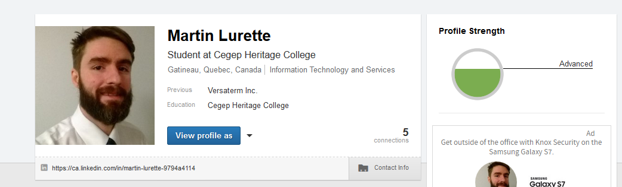
Step 1: Update LinkedIn

Slide 6
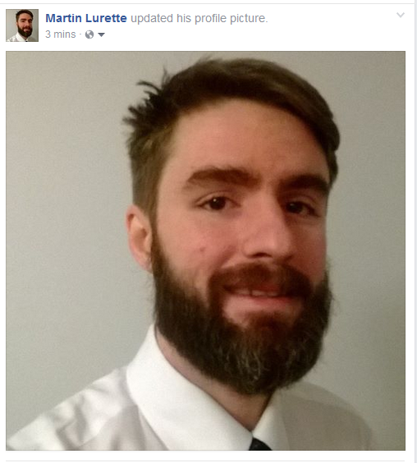
Step 2 : Update Facebook picture

Slide 7
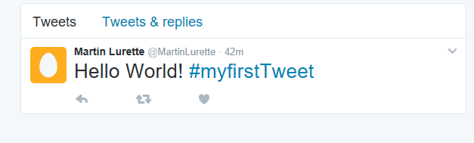
Step 3: Create Twitter Account

Slide 8
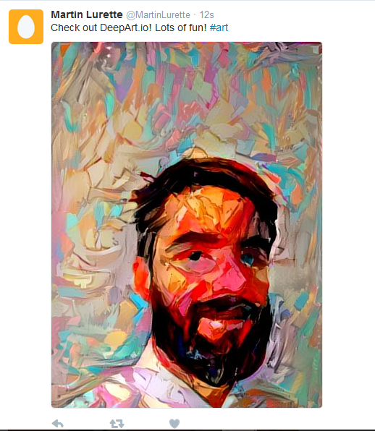
Make some tweets

Slide 9
Conclusion
Better online presence is key for networking
Simple to start
Requires upkeep every now and then.

